Slide 1
Progress report
Notes and updates on progress
ELECTRICAL

Slide 2
as at 6/16/2023
Completed:
Completed tests on the e-tricycle modules
Solar panel- fine, output open circuit voltage= 20.0V
Battery cabinet- batteries in good condition, voltage obtained across battery= 52.7V
Boost converter- not giving the expected output of ~55V, troubleshooting pending
Powertrain simulation MATLAB- did a powertrain simulation to estimate the range of the bike. Translated the mechanical parts to electrical signals
Motor controller simulation- chop the speed to 16~20m/s
.slx file given
Tasks
Battery management System modelling
Boost converter troubleshooting or new design when it fails

Slide 3
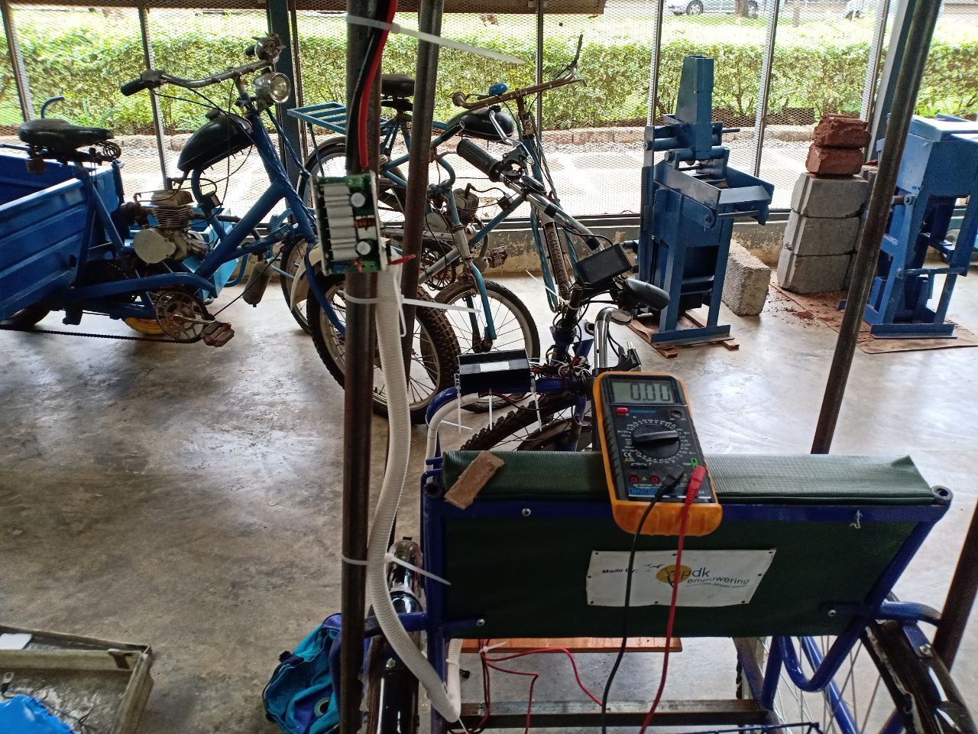
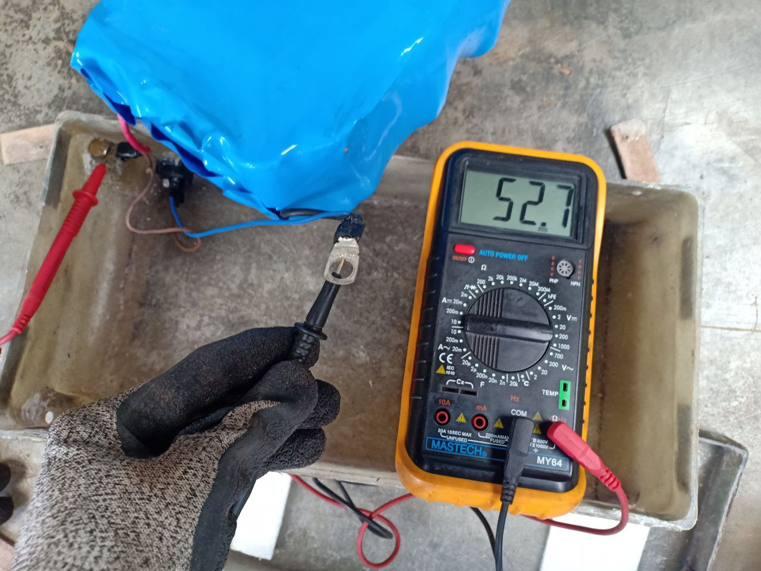
Boost module not giving output
Voltage of the battery Open Circuit

Slide 4
as at 7/4/2023
Completed:
Completed tests on the e-tricycle modules
Solar panel- fine, output open circuit voltage= 20.0V
Battery cabinet- batteries in good condition, voltage obtained across battery= 52.7V
Boost converter- not giving the expected output of ~55V, troubleshooting pending
Powertrain simulation MATLAB- did a powertrain simulation to estimate the range of the bike. Translated the mechanical parts to electrical signals
Motor controller simulation- chop the speed to 16~20m/s
.slx file given
Known issues:
Distance range under the assumption of a linearly discharging battery hence not accurate: 1
Tasks
Battery management System modelling
Boost converter troubleshooting or new design when it fails

Slide 5
PROJECT IMPLEMENTATION
BATTERY SYSTEM
ELECTRIC CIRCUITS SIMULATIONS
3D CAD&
SIMULATION
MECHANICAL FABRICATION
CHASIS FABRICATION
PARTS FITTING& IMPLEMENTATION
ELECTRONIC FITTING&
ELECTRICAL CIRCUITS
E-TRICYCLE

Slide 6
Battery system
Battery Management System
Tasks completed:
Identified a module to be used with the current battery pack
13s 30A 48V BMS module here
Pending tasks
Investigating a communication protocol for the battery to interface with the user display.
This will be helpful to provide real time status of the battery, battery percentage hence help the user to charge. Planning to make a user friendly and ‘poka-yoke’ display for the battery system and to alert the user on time to charge
Simulating the conditions of the battery with MATLAB to get the time of charge and discharge time and conditions

Slide 7
Battery system
Challenges faced
Identifying an optimal communication protocol for the trike taking into consideration the overall cost of the e-tricycle
Protocols identified:
CAN
The CAN communication needs a CAN enabled Battery and motor controller for the communication.
Making the battery CAN enabled?
This requires the CAN interface module and CANNY software to make one. Complex to actually fix the baud rate and perfect it for the system.
I have asked ROAM and ARC ride for CAN formulation assistance but it has been labelled under proprietary company information and the interns are under legally binding NDAs
We can use pre-existing CAN protocols in the market and program it to suit our battery capacity but will require new CAN-OPEN enabled battery which adds to the cost.
Pre existing CAN devices for the consulted e-mobility companies are labelled as proprietary info.
This requires only to check in e commerce websites? E-tractor team internship?

Slide 8
Battery system
RS-485 communication
The RS-485 communication is found in modern BMS module and can be interfaced with Arduino-Nano or any micro controllers to display the battery status in the dashboard.
Tasks for the week:
Identify the best protocol to implement
Model of circuit diagrams for the BMS system

Slide 9
Battery system
RS-485 communication
The RS-485 communication is found in modern BMS module and can be interfaced with Arduino-Nano or any micro controllers to display the battery status in the dashboard.
Tasks for the week:
Identify the best protocol to implement
Model and simulations of circuit diagrams for the BMS system
Documentation

